Slide 1
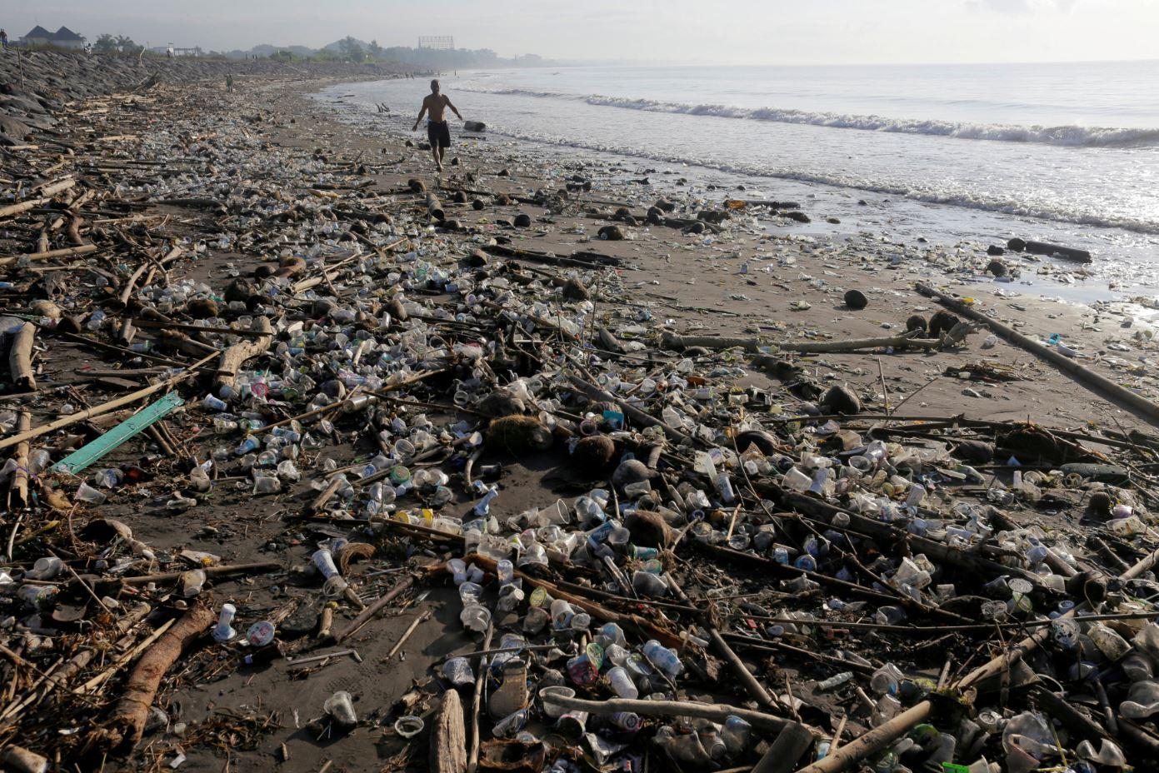
Deaths Attributable to the Environment

Slide 2

Data Background
Data source: World Health Organisation (“WHO”)
WHO conducted a global assessment of the burden of disease attributable to environmental risks, estimating how much of global disease could be prevented by modifying the environment.
The percentage of total deaths that are attributable to the environment.
Causes of death are divided into the following 3 categories:
Infectious, parasitic, neonatal and nutritional (includes deaths of women and newborns that were related to pregnancy and birth and deaths from insufficient nutrient intake, sexually transmitted diseases including HIV/AIDS, tuberculosis, diarrheal diseases, some vaccine-preventable diseases such as measles, and diseases caused by tropical parasites such as malaria and hookworm)
Injuries (includes intentional - e.g. road traffic collisions, falls, drownings and natural disasters, and unintentional - e.g. self-inflicted, homicidal)
Noncommunicable diseases (“NCDs”) (diseases cannot be spread directly from one person to another - e.g. hepatitis B or C infection, diabetes, cardiovascular diseases and cancers). NCDs disproportionately affect people in low- and middle-income countries
Sources:
https://platform.who.int/mortality/themes/theme-details/mdb/communicable-maternal-perinatal-and-nutritional-conditions
https://platform.who.int/mortality/themes/theme-details/mdb/noncommunicable-diseases
https://platform.who.int/mortality/themes/theme-details/mdb/injuries

Slide 3



Data Background
The data provides an estimate of the fraction of disease that could be prevented through healthier environments or by modifying the environment including through the following factors:
Air, soil and water pollution with chemicals or biological agents
Ultraviolet and ionizing radiation
Noise, electromagnetic fields
Anthropogenic climate changes, ecosystem degradation
Individual behaviors related to the environment; such as hand-washing, food contamination with unsafe water or dirty hands
Agricultural methods, irrigation schemes
Source: https://www.who.int/data/gho/indicator-metadata-registry/imr-details/4655

Slide 4



Data Fetching & API Integration
Data cleaning: Python, Pandas, Jupyter Notebook
Database: SQLite3, sqlAlchemy
API: Flask, sqlAlchemy
Javascript library: Plotly, Chart JS and Leaflet

Slide 5
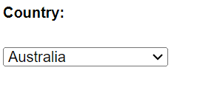
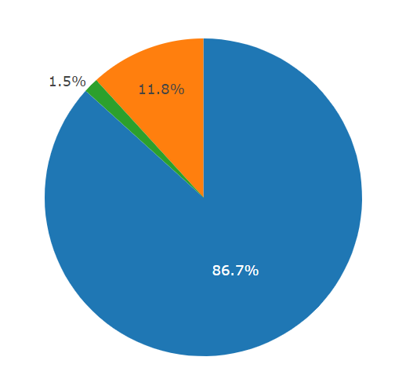
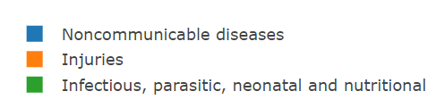
Indicator deaths as a % of total deaths - Australia
Noncommunicable diseases - 86.7%
The data shows that the leading environmental indicator leading to death in Australia, is non-communicable disease (NCD) with 86.7% of total deaths attributable to the environment falling within this category. NCDs includes illnesses such heart disease, stroke, cancer, diabetes and chronic lung disease.
Injuries - 11.8%
Injuries comprising 11.8% of total deaths include unintentional injuries (such as road accidents, falls, drowning etc) as well as violence related injury (including suicide, homicide, war).
Infectious, parasitic, neonatal and nutritional - 1.5%
The true number of deaths related to infectious disease, parasites, insufficient nutrition as well as deaths related to pregnancy and birth, are not fully represented within the data as there are some countries where these types of deaths are more common do not collect comprehensive data related to causes of death

Slide 6
Deaths vs GDP
The data shows a correlation between GDP and deaths attributable to the environment.
Countries with lower GDP experience a higher number of deaths as a percentage of population, and these deaths are most commonly attributed to to infectious diseases, parasites, pregnancy and nutritional conditions.
Whereas as wealthier countries experience a lower number deaths, and these deaths are most commonly attributable to non-communicable diseases.
Highlights from the data
Interestingly, China and the US which have comparative GDP (18.5 trillion and 19 trillion respectively), however China has a higher proportion of deaths as a % of population 0.22% than the US at 0.09%. This may indicate that the United States contributes a higher proportion of funding toward health care and health care initiatives.

Slide 7
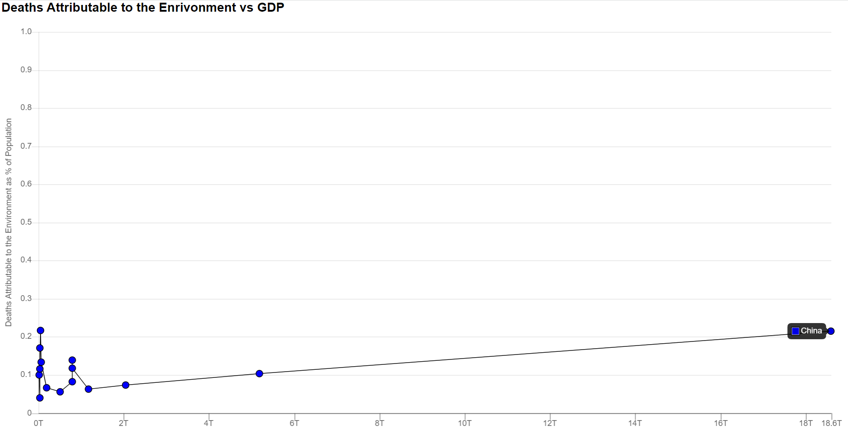

Deaths vs GDP
South-East Asia

Slide 8
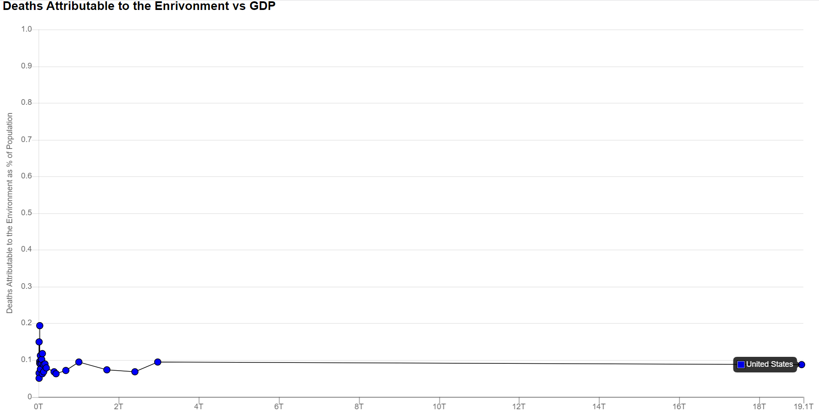
Deaths vs GDP
Americas

Slide 9
Total deaths as % of population
Worldwide
6 African countries - Central African Republic 0.33%, Sierra Leone 0.33%, Chad 0.31%, Congo 0.30% Burundi 0.27%, Angola 0.27%
4 European countries - Georgia 0.33%, Moldova 0.32%, Ukraine 0.3% , Bosnia & Herzegovina 0.28%
The death rates are relatively consistent among the top 10 countries, with a narrow range of 0.06%.
By continent
Africa - Central African Republic 0.33%, Sierra Leone 0.33%, Chad 0.31%, Congo 0.30% Burundi 0.27%, Angola 0.27%
Americas – Haiti 0.19%, Guyana 0.15%, Bolivia 0.12%, El Salvador 0.11%, St Lucia 0.11%
Eastern Mediterranean – Somalia 0.24%, Afghanistan 0.19%, Sudan 0.18%, Pakistan 0.16%, Djibouti 0.14%
Europe - Georgia 0.33%, Moldova 0.32%, Ukraine 0.3% , Bosnia & Herzegovina 0.28%, Armenia 0.27%
South East Asia – India 0.22%, Myanmar 0.21%, Bhutan 0.17%, Nepal 0.17%, Sri Lanka 0.16%
Western Pacific – Lao PDR 0.22%, China 0.22%, Mongolia 0.17%, Vietnam 0.14%, Cambodia 0.13%
The above statistics link back to our analysis on the correlation between GDP and the prevalence of preventable environmental-related deaths.

Slide 10
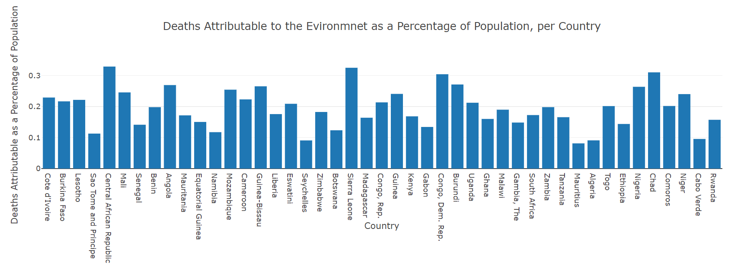
Total deaths as % of population
Africa

Slide 11
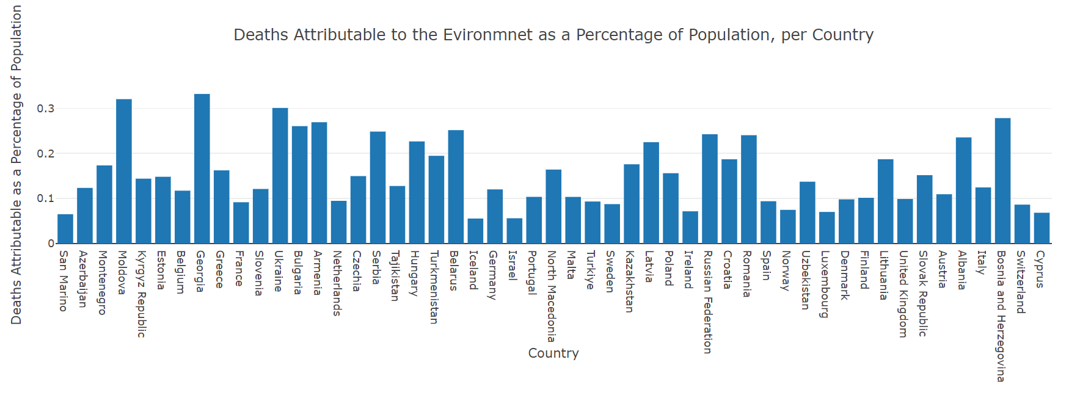
Total deaths as % of population
Europe

Slide 12
Summary Analysis
Continents with the lowest GDP, including Africa, Eastern Mediterranean, and South-East Asia, face a higher percentage of deaths due to infectious diseases, parasites, pregnancy, and nutritional issues. Africa has the highest proportion of deaths in this category, followed by South East Asia and the Eastern Mediterranean
WHO research in 2017 showed that in Africa, 50% of children 5 years and under die from illnesses like pneumonia, malaria, HIV, and measles. Less than 2% of drugs are made locally, limiting access to life-saving medicines. Imported drugs may be unaffordable.
Wealthier continents (Americas, Europe, Western Pacific) face more noncommunicable diseases (e.g, heart disease, cancer) due to lifestyle factors (e.g. smoking, high caloric diet and insufficient physical activity). Infectious disease deaths are significantly lower for these continents than their less wealthier counterparts.
The ratio of injury-related deaths to total deaths ranges from 11% to 20% across continents. Injuries stem from various causes like violence, accidents, and disasters. The Americas have the highest ratio (20.8%) due to violence, particularly in Brazil and Mexico. Africa follows closely at 18.8%, mainly from accidental incidents, particularly in South Africa
Source: https://www.un.org/africarenewal/magazine/december-2016-march-2017/dying-lack-medicines

Slide 13
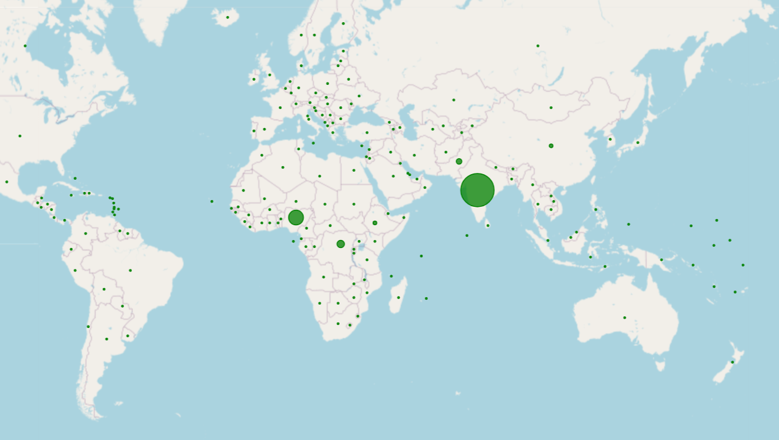
Summary Analysis
Infectious, parasitic, neonatal and nutritional

Slide 14

Future Considerations & Research
Deeper analysis of each indicator to facilitate additional insights which would support the development of programs / initiatives aimed at prevention and education to alleviate associated deaths
A demographic profile (age, gender) for each indicator by country continent
Analysis on the impact of environmental factors such as air pollution, water quality and climate change
Investigate the effects of urbanization, including issues related to inadequate housing, overpopulation and sanitation on health and mortality
Analyse the health and mortality implications of climate change including severe weather incidents, heat-related illnesses and food insecurity

Slide 15

Thank you for listening

